Slide 1
Spatio-Temporal Modelling and Algorithms for Rapid Detection of Pathogenic DNA
12th July 2021
MEng Final Year Project 2021
Kunal Katarya
EIE 4
01066347

Slide 2
Presentation Overview
Introduction
Project Motivation
Background Material
Improvements to Mathematical Model
Methodology
Results
Spatio-Temporal Algorithms
Methodology
Results
Validation with Experimental Data
Conclusions

Slide 3
Introduction

Slide 4
Project Motivation
Introduction
COVID-19 Pandemic → better testing systems needed for epidemiological surveillance
Testing for presence of virus in sample → biomarker detection
Type of Biomarker Detected | Protein (Antigen/Antibody) | DNA
Example | Rapid Antigen Test | PCR test
Advantages | Cheap ($5) Fast detection (< 30 minutes) “Point of care” (PoC) diagnostics | Gold standard in accuracy Works with low biomarker concentration Quantitative Output
“Let’s build a test that does all these things!” – Imperial CBIT
Notes:
Problem statement:
List disadvantages of both and say we want to fix

Slide 5
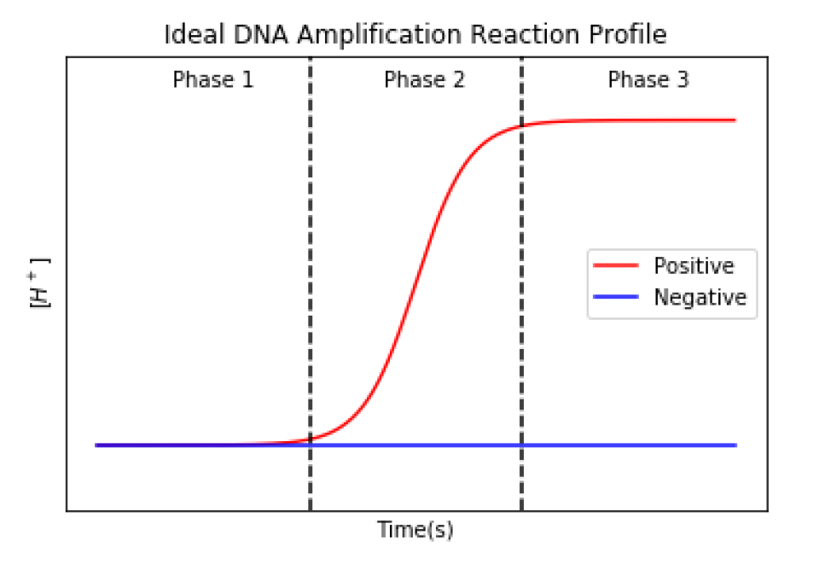
Loop-Mediated Isothermal Amplification (LAMP)
Background Material
DNA amplification reaction
Chemical solution reacts with target DNA molecules
Products: DNA molecules, protons
Fast → ~40 minutes
Time-to-positive (TTP) → Quantitative Output
Stage 1
Reaction yet to commence
Stage 2
Amplification
Stage 3
Saturation
Notes:
Shorter script

Slide 6
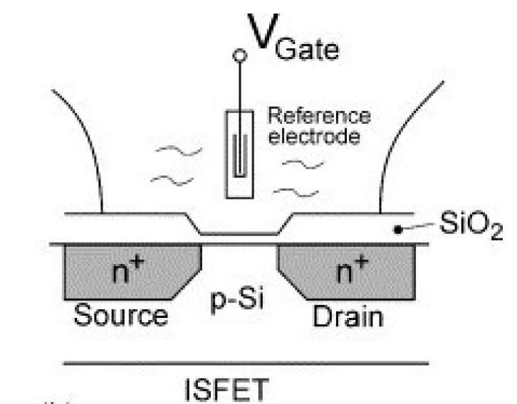
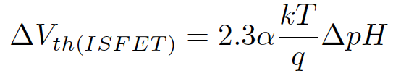
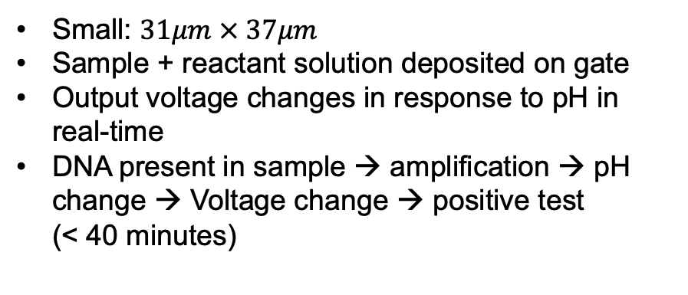
Ion-Sensitive Field-Effect Transistor (ISFET)
Background Material
How do we detect changes in solution pH (cheaply, quickly and reliably)?
Enter, the ISFET...
Small: $31μm × 37μm$
Sample + reactant solution deposited on gate
Output voltage changes in response to pH in real-time
DNA present in sample → amplification → pH change → Voltage change → positive test (< 40 minutes)
Notes:
Useless:
Equation
size

Slide 7
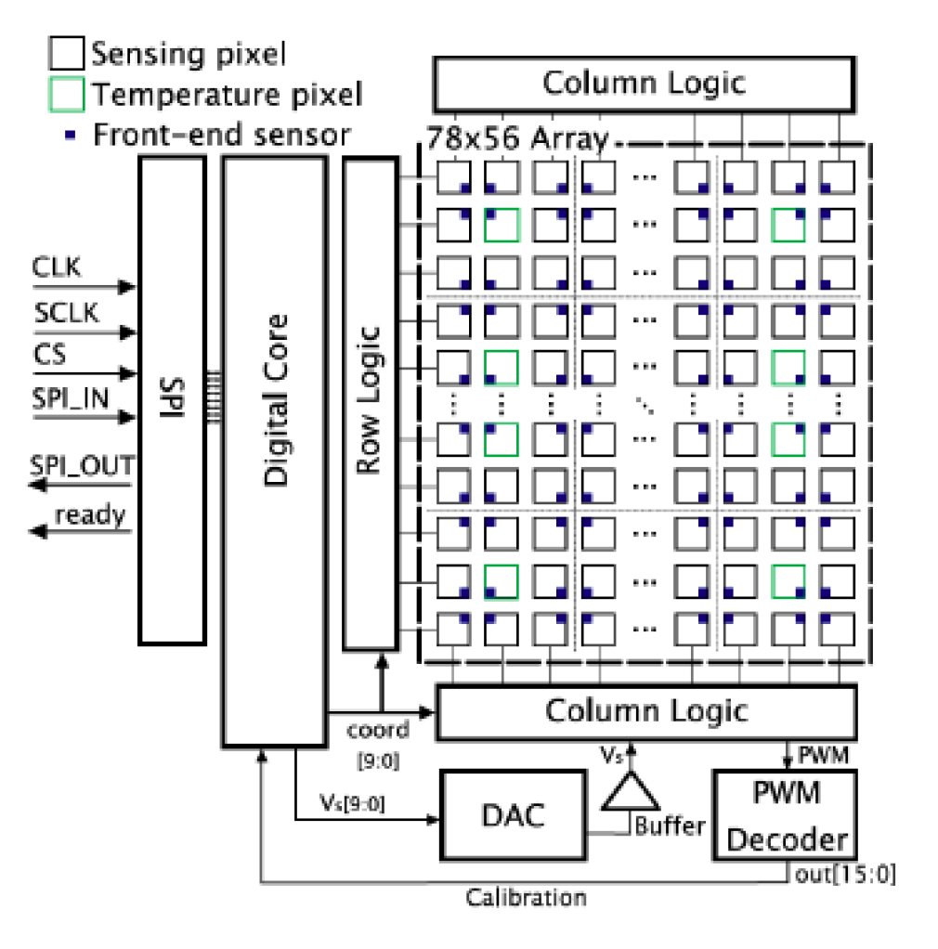
LACEWING Microchip: TITANICKS
Background Material
2-D array (78 x 56) of sensors (pixels)
2-D arrangement of ISFETs captures:
1. Temporal data
Change in solution pH over time
2. Spatio-temporal data
Change in spatial distribution of protons over time

Slide 8
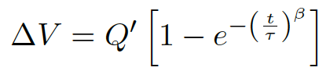
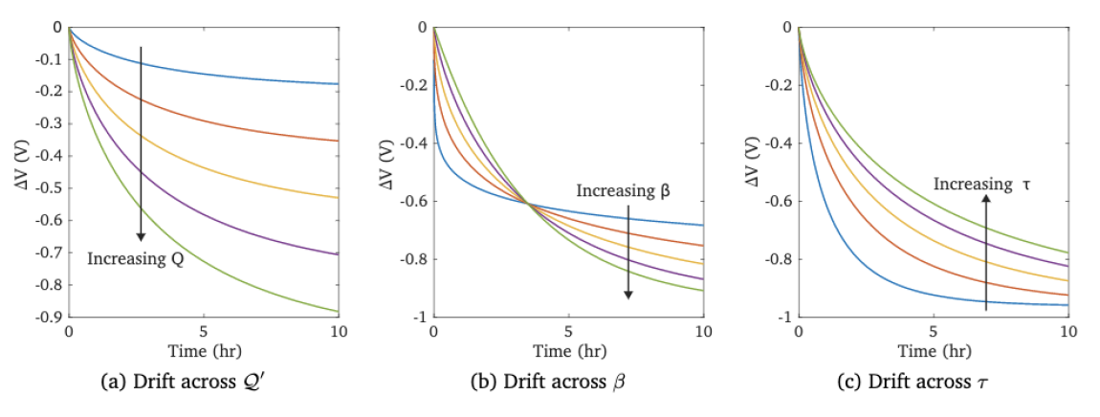
TITANICKS: Signal Non-Idealities
Background Material
Sensor Drift
ISFET output changes independently of solution pH
Modelled as decaying exponential in prior work
Others
Modelled as Additive White Gaussian Noise
Notes:
Useful but make it very short
No origins

Slide 9
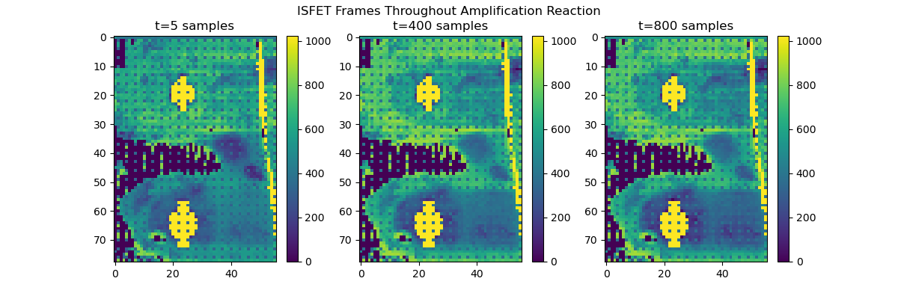
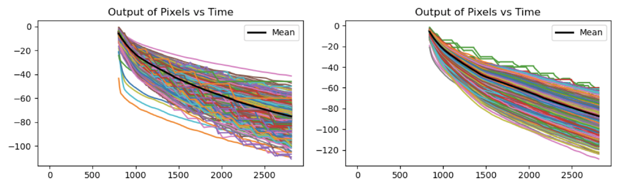
TITANICKS: Output Signals
Background Material
Two ways to interpret output signal
Spatio-Temporal Signal
Temporal Signal
Control, no DNA
Control
Sample
Sample to test
Voltage output of each ISFET vs time
Patterns in spatial distribution of voltage
Notes:
Explain later

Slide 10
Mathematical Model
Background Material
Goal: simulate the LAMP reaction on an ISFET array, produce datasets to train algorithms on
Overview
Randomly initialize DNA molecules in 3D space
DNA molecules grow in spherical clusters, release protons around surface
Randomly assign protons to ISFETs using statistical approximation
Output dataset: # of protons per ISFET over 40 minutes
Discrepancies between model and experimental output
Type of output: number of protons detected vs voltage
Noise not modelled
Protons released in clusters, but randomly assigned to ISFETs → loss of spatial information
Notes:
revmove

Slide 11
Improvements to Mathematical Model
Focus on spatial information preservation

Slide 12
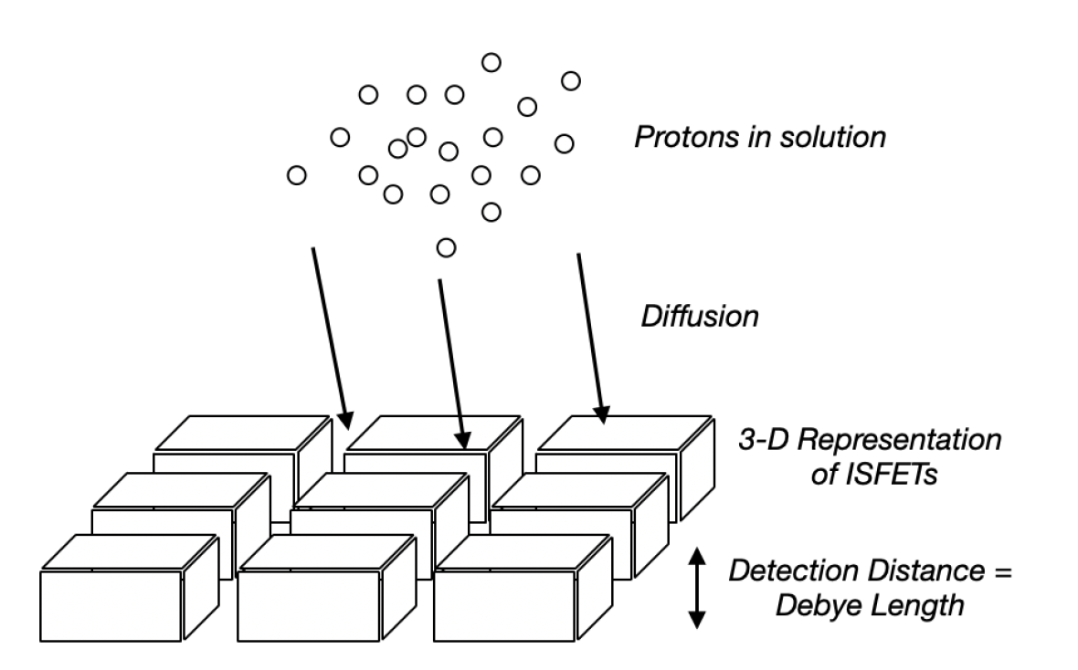
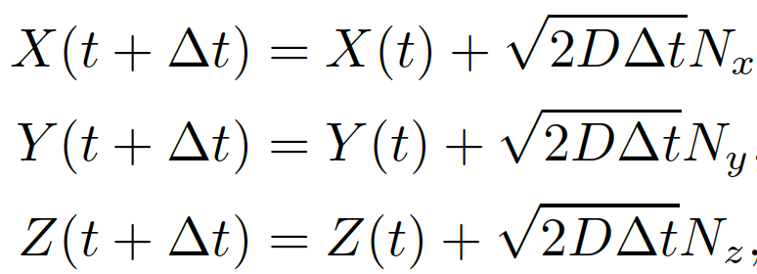
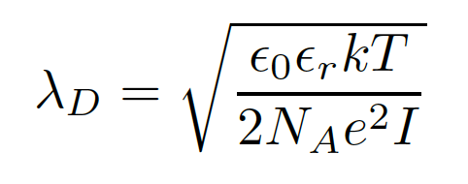
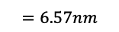
Spatial variation of proton capture
Mathematical Model – Spatial Variation of Proton Release
Fundamental changes
1. Diffusion of individual protons modelled using Smoluchowski Equations:
2. ISFETs detect protons within one Debye Length from their surface:
$$=6.57nm$$
3. Model accounts for gaps between ISFETs
Notes:
Keep this, make it debye + diffusion

Slide 13
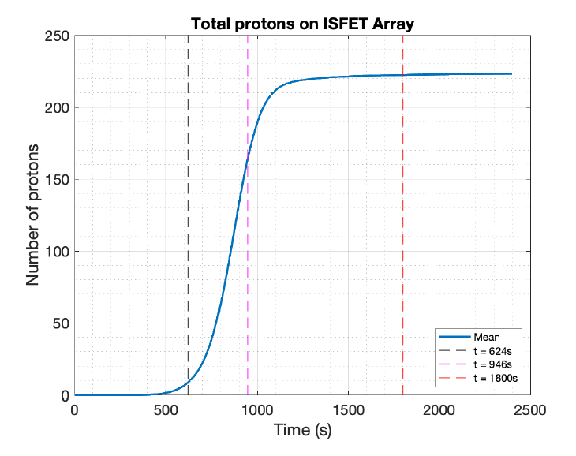
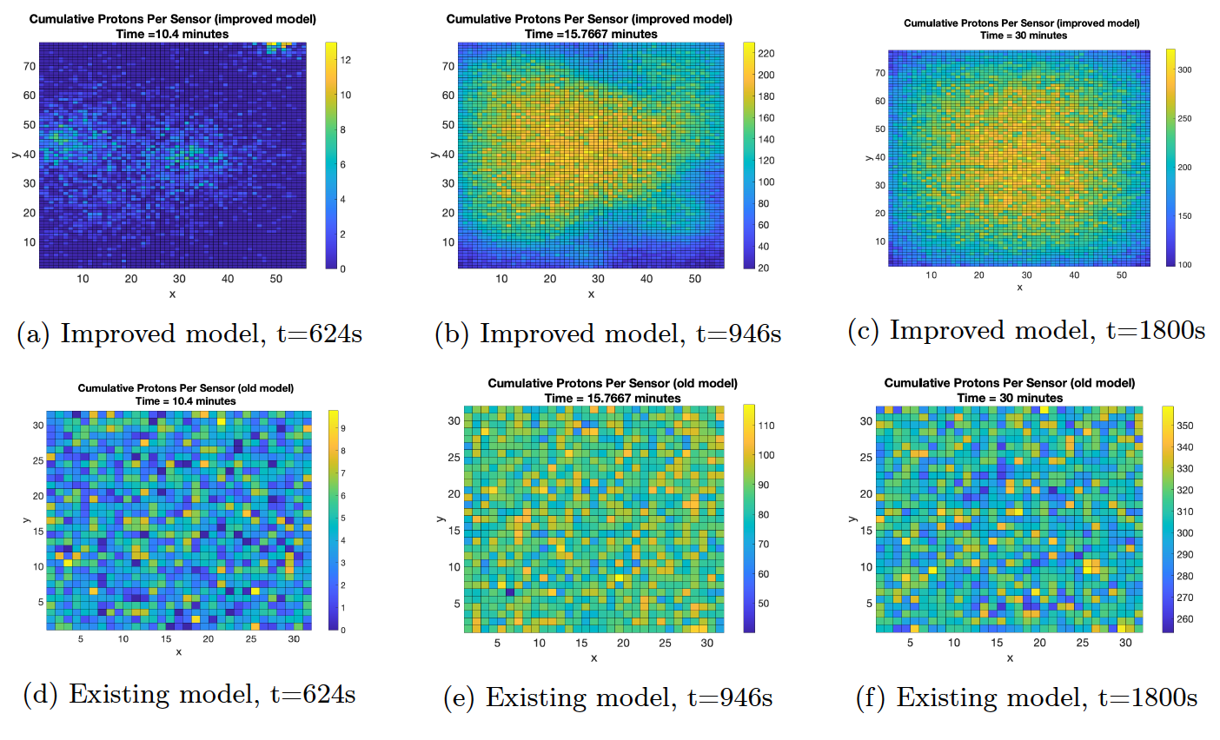
Results of spatial modelling
Mathematical Model – Results
Existing vs Improved model
Tune both models to produce same temporal output
Temporal TTP: 10% of total protons detected = 750s
Investigate difference in spatial signals
Visible clustering of protons in improved model
Hotspots visible before temporal signal TTP → potential for spatio-temporal algorithms to reduce TTP
Notes:
keep

Slide 14
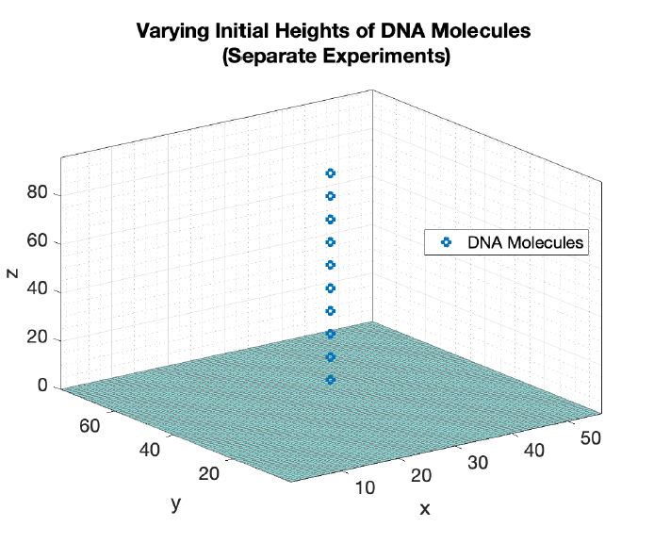
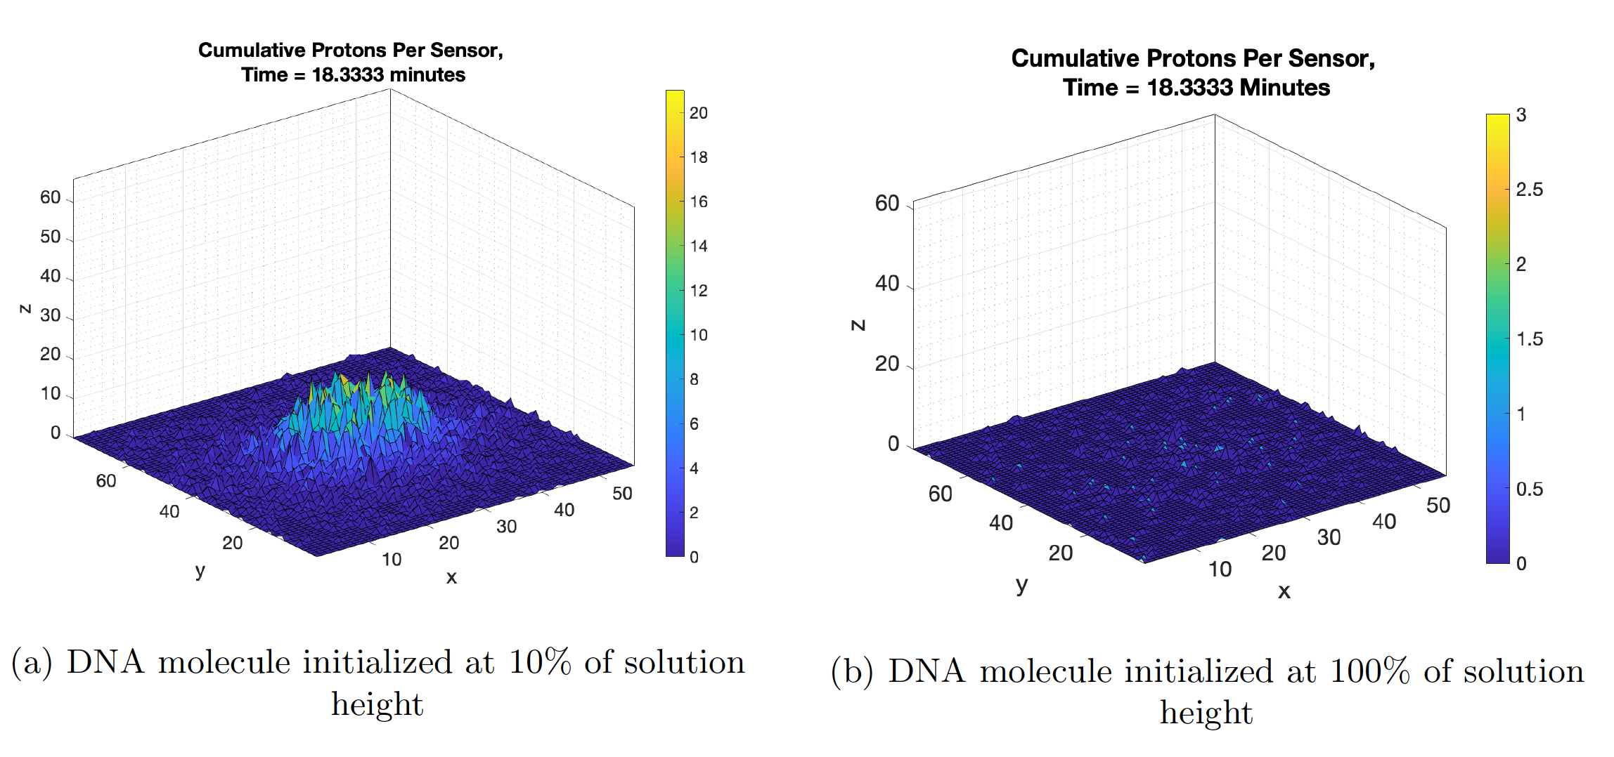
Exploration of Spatial Signal
Mathematical Model – Results of Spatial Modelling
How does the distribution of DNA molecules affect the spatial signal?
10 simulations, each initialized with 1 initial DNA molecule in the middle of the solution at different heights
Molecule begins amplification at t=1054 seconds
Observe spatial signal at t=1100 seconds
Spatial signal of molecule initialized closer to ISFET array contains visually discernable and concentrated hotspot
Spatial signal of molecule initialized higher → more “diffuse”, no hotspot
Can we quantify the intensity
of hotspots?
Notes:
kep

Slide 15
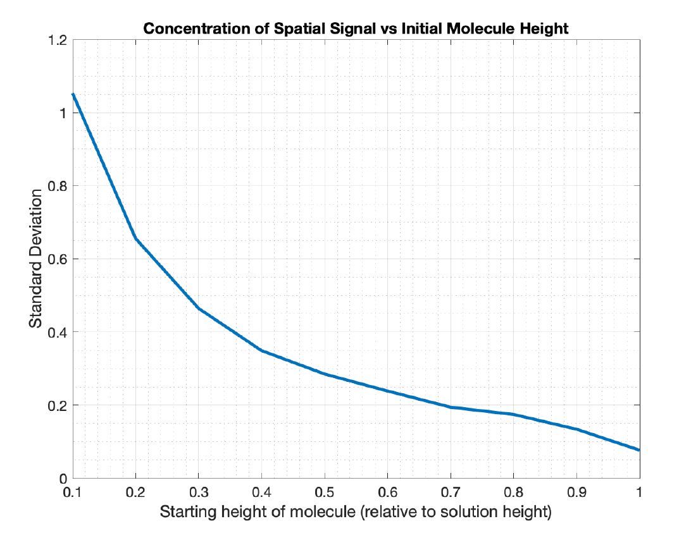
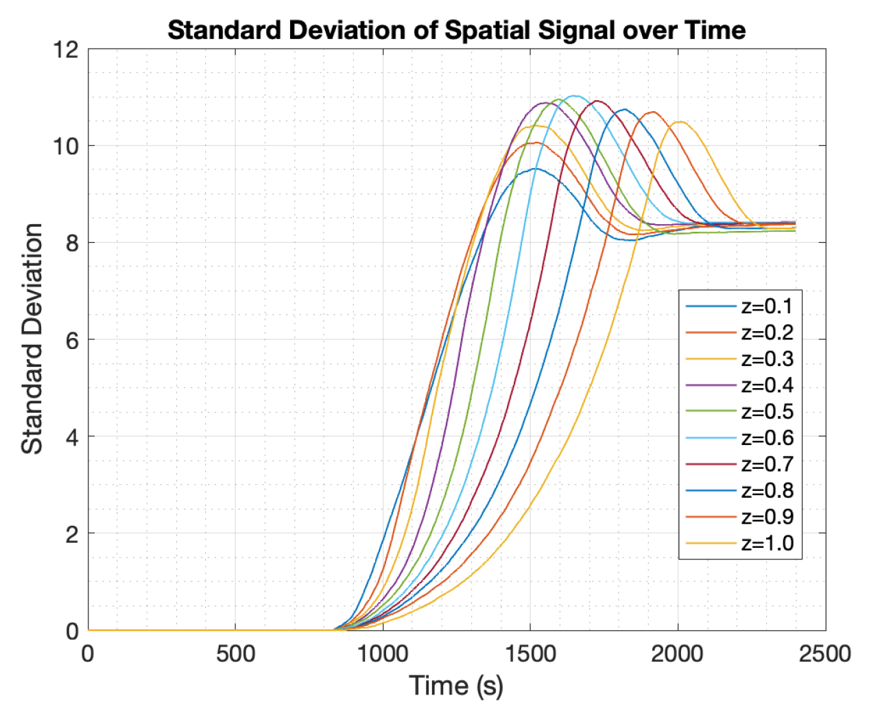
Exploration of Spatial Signal
Mathematical Model – Results of Spatial Modelling
Using standard deviation as a metric for detecting hotspots
Standard Deviation of Spatial Signal → Intensity of hotspots
As hotspots become more intense at t=1100s, standard deviation across the frame increases
Implication: molecules closer to the ISFET array create hotspots faster
Notes:
chuck

Slide 16
Spatio-Temporal Algorithm

Slide 17
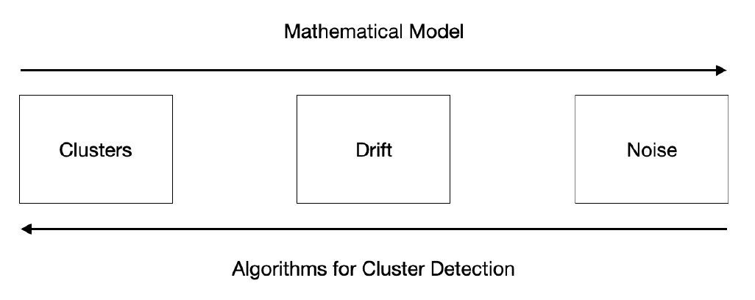
Methodology
Algorithms - Methodology
General Strategy:
Proposed algorithm reverses the process of dataset generation
Drift compensation followed by standard deviation to detect clusters
Dataset A: n=1000 DNA molecules, sample well
Dataset B: n=0 DNA molecules, control well
2 Datasets Generated from Model:
Notes:
Keep
This section make script

Slide 18
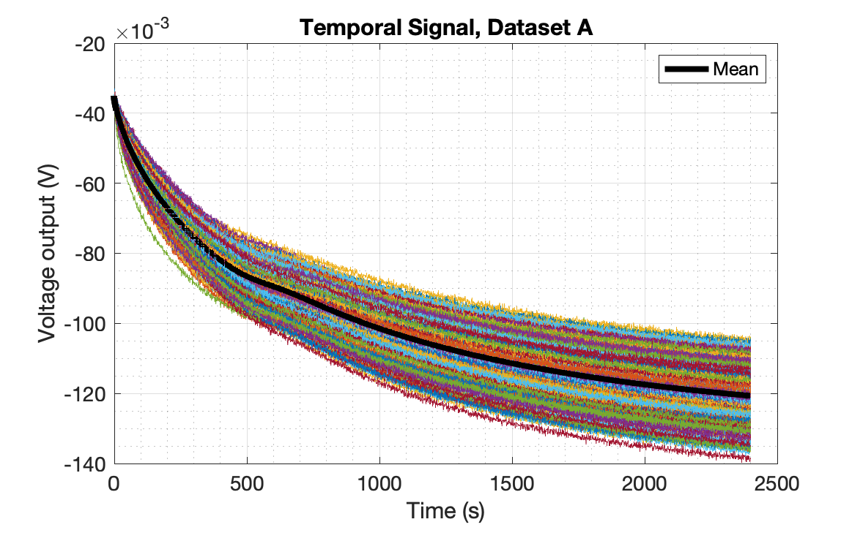
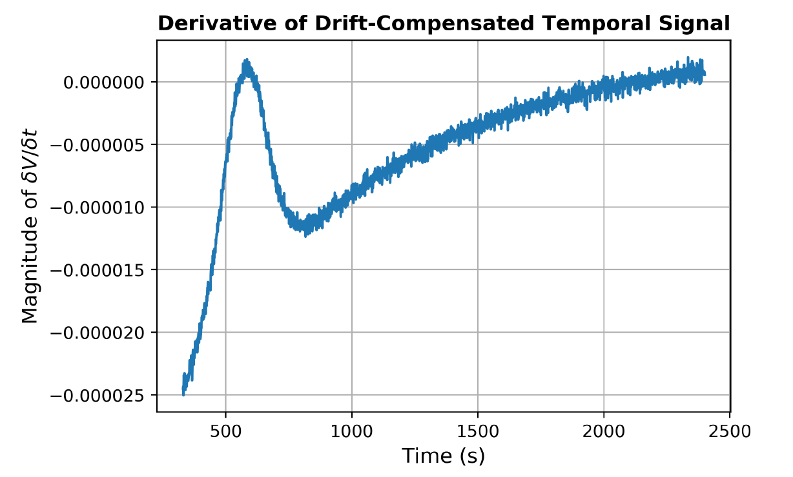
Baseline Temporal Algorithm
Algorithms - Methodology
Compute gradient of mean temporal signal
Detect peak in gradient = time of maximum rate of amplification
TTP = 575 seconds

Slide 19
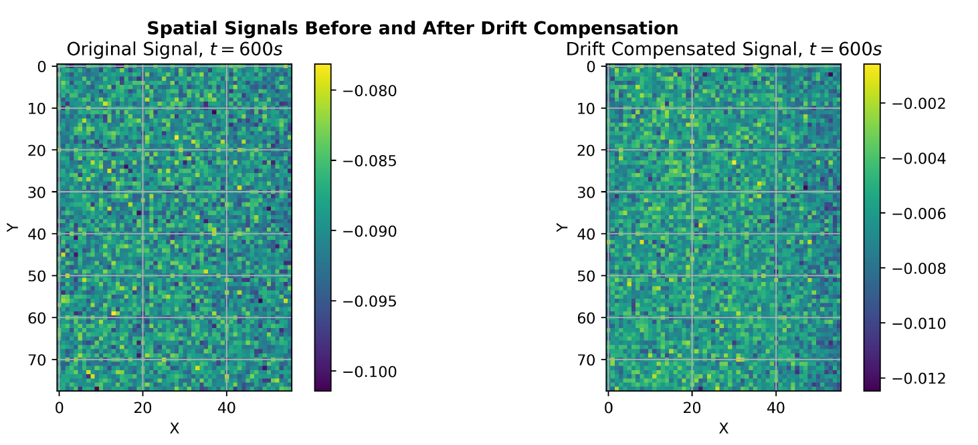
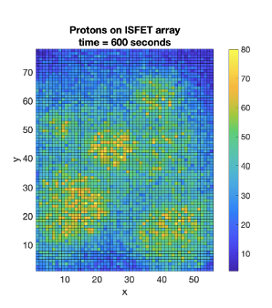
Spatio-Temporal Algorithm
Algorithms - Results
Drift Compensation
Drift compensation performed using first 300 samples of output from each ISFET (only drift)
For each ISFET: Curve fitting (decaying exponential) → Drift modelled → Subtract extrapolated drift
Proton Distribution at t=600s
Result: Improved signal-to-noise ratio

Slide 20
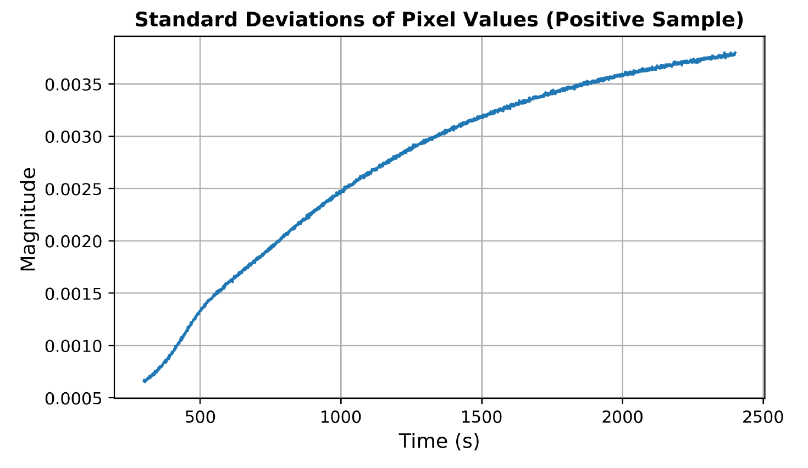
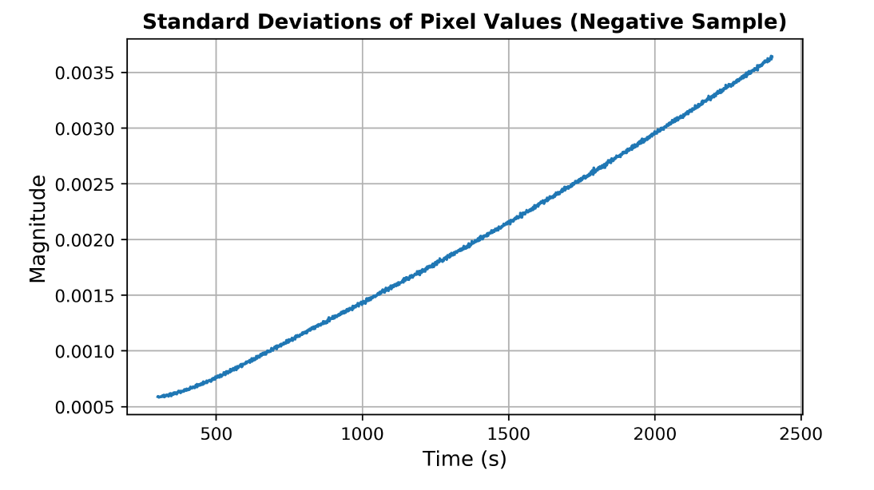
Spatio-Temporal Algorithm
Algorithms - Results
Spatial standard deviations of sample and control datasets
Kink in signal from sample dataset – emergence of clusters?

Slide 21
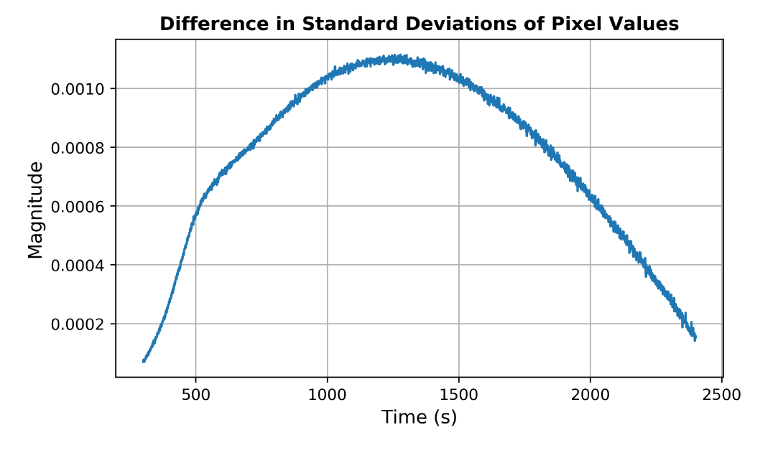

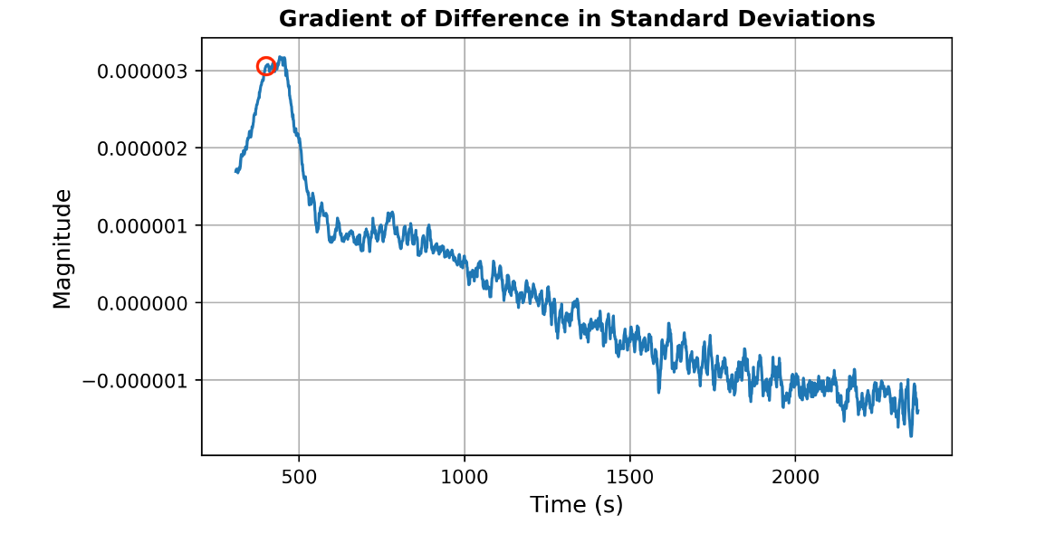
Spatio-Temporal Algorithm
Algorithms - Results
Winner!
Compute Derivative
(1-sample rolling difference)
Ensure kink is not an artefact of noise
Define peak in gradient = first
emergence of clusters
TTP = 384 seconds (33.2% improvement)

Slide 22
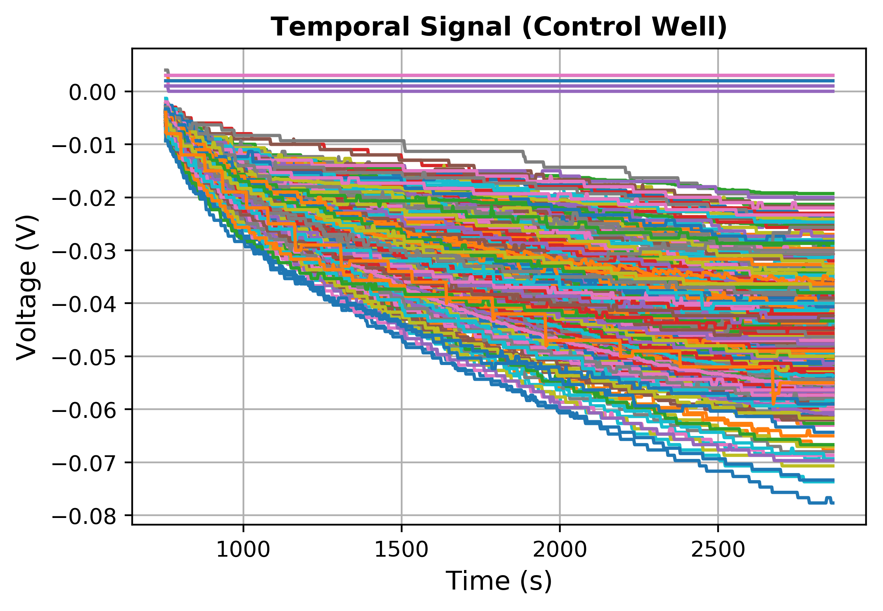
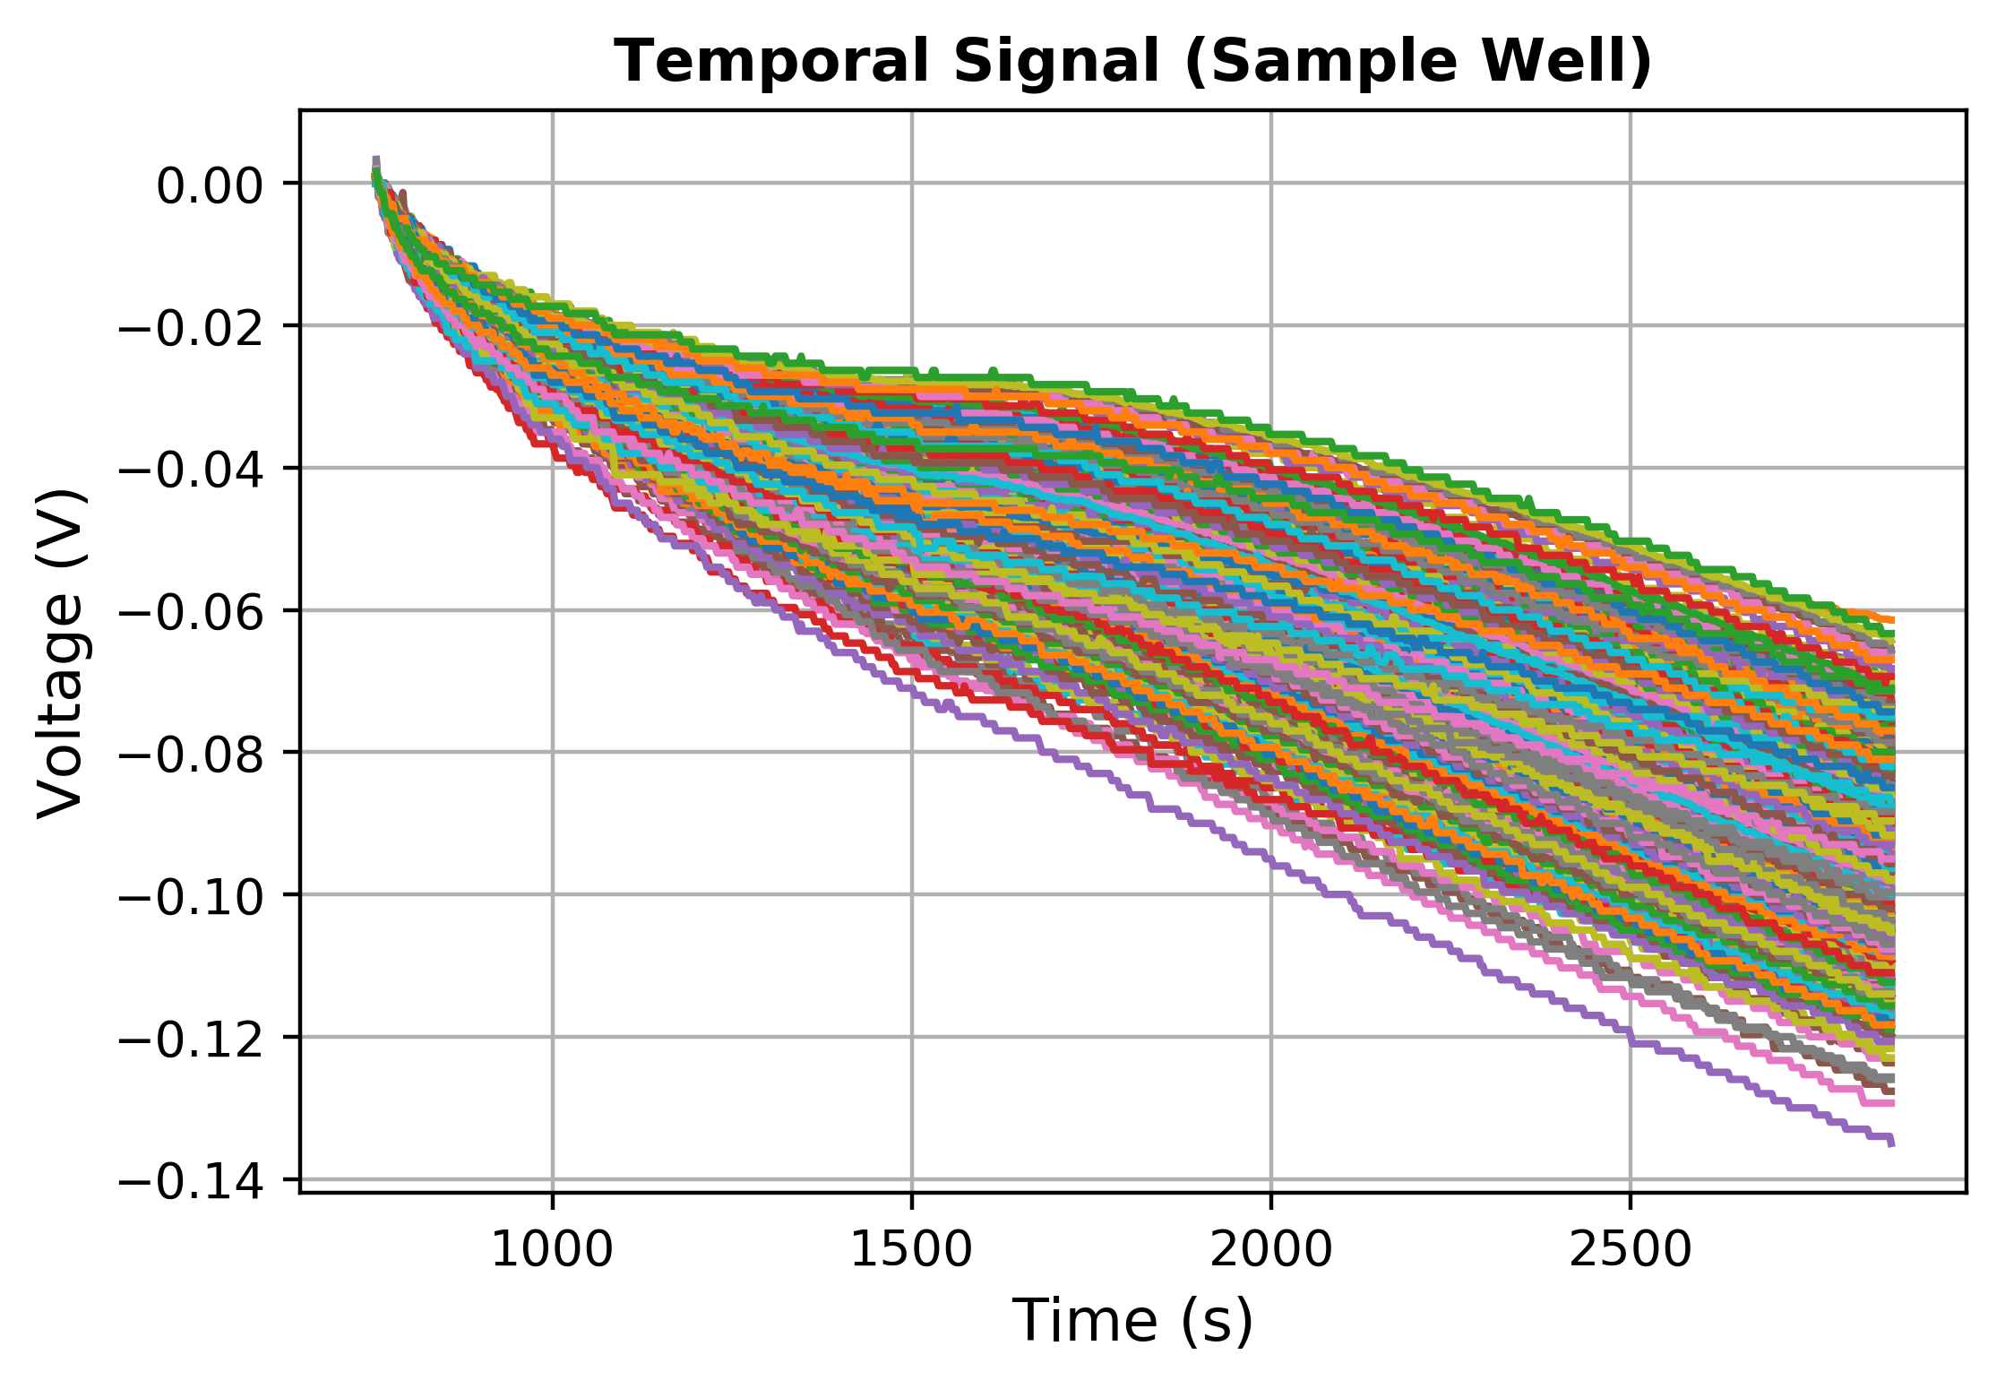
Validation on Experimental Data
Algorithms - Validation
Dataset: COVID-19 test conducted on LACEWING, 2020
Amplification
Signals start at t=718 s, when sample was loaded

Slide 23
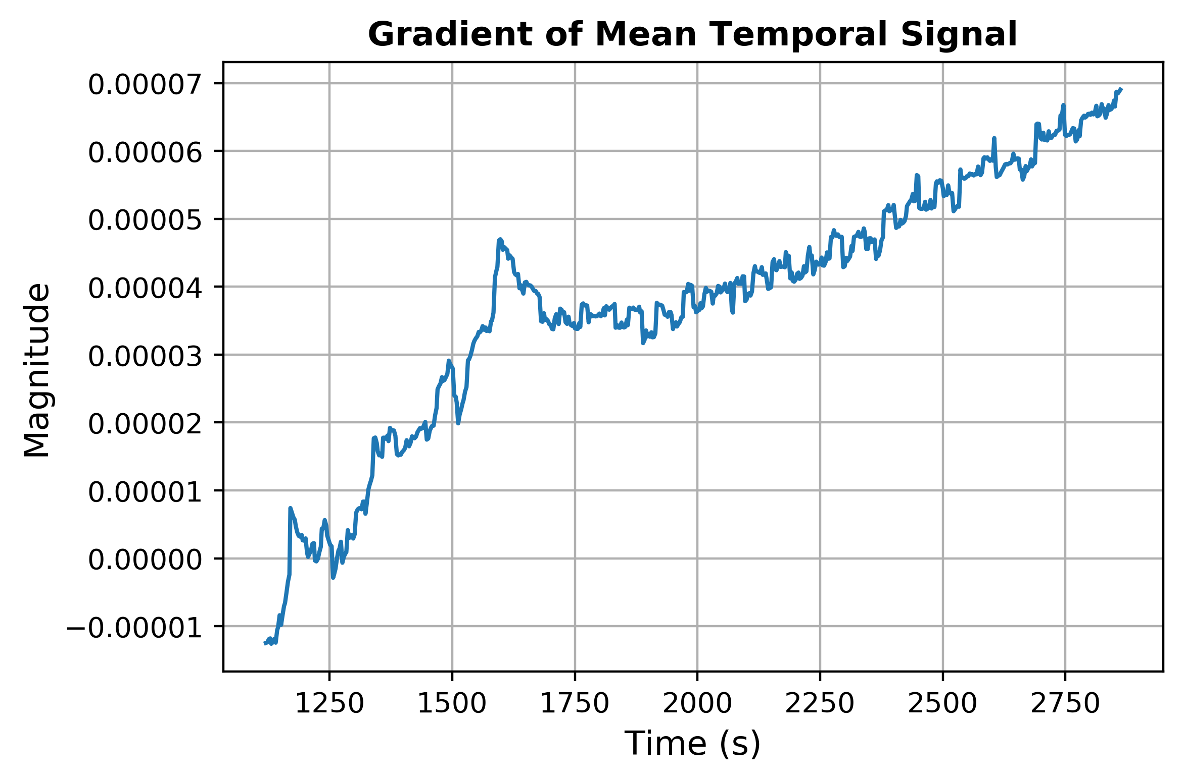
Baseline Temporal Algorithm
Algorithms - Validation
Peak observed at 1617 seconds, TTP = 899s

Slide 24
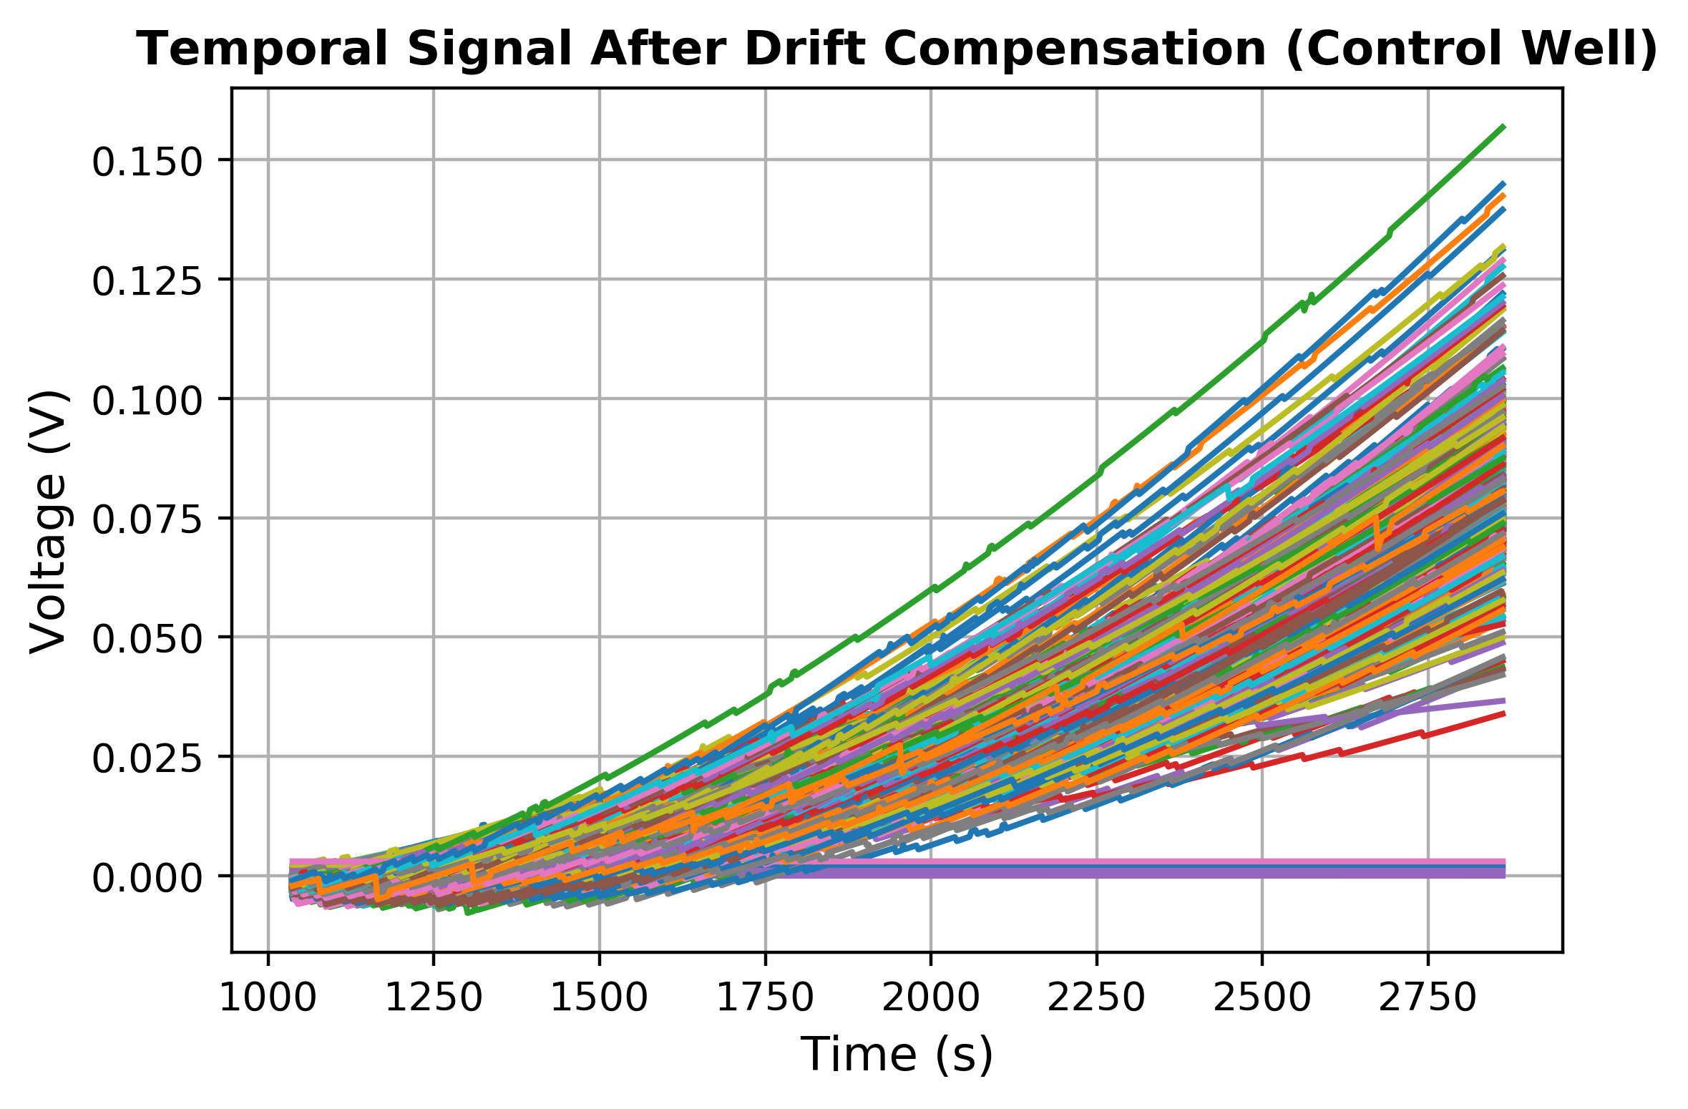
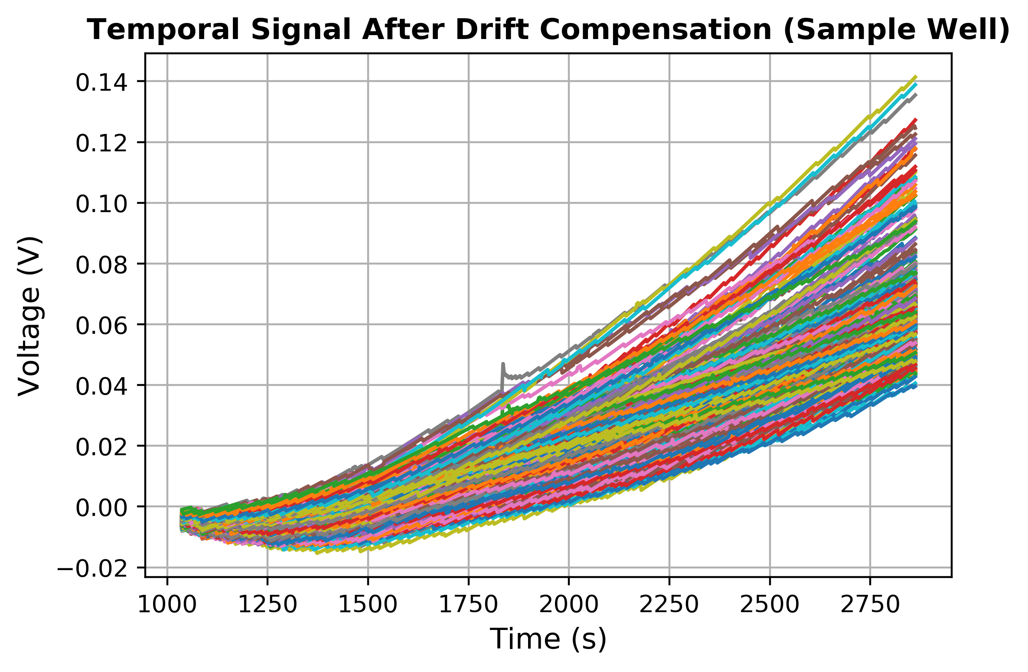
Spatio-Temporal Algorithm
Algorithms - Validation
Temporal signals after per-ISFET drift compensation
(300 seconds, 100 datapoints for curve fitting)
Expecting almost flat lines → needs better drift compensation

Slide 25
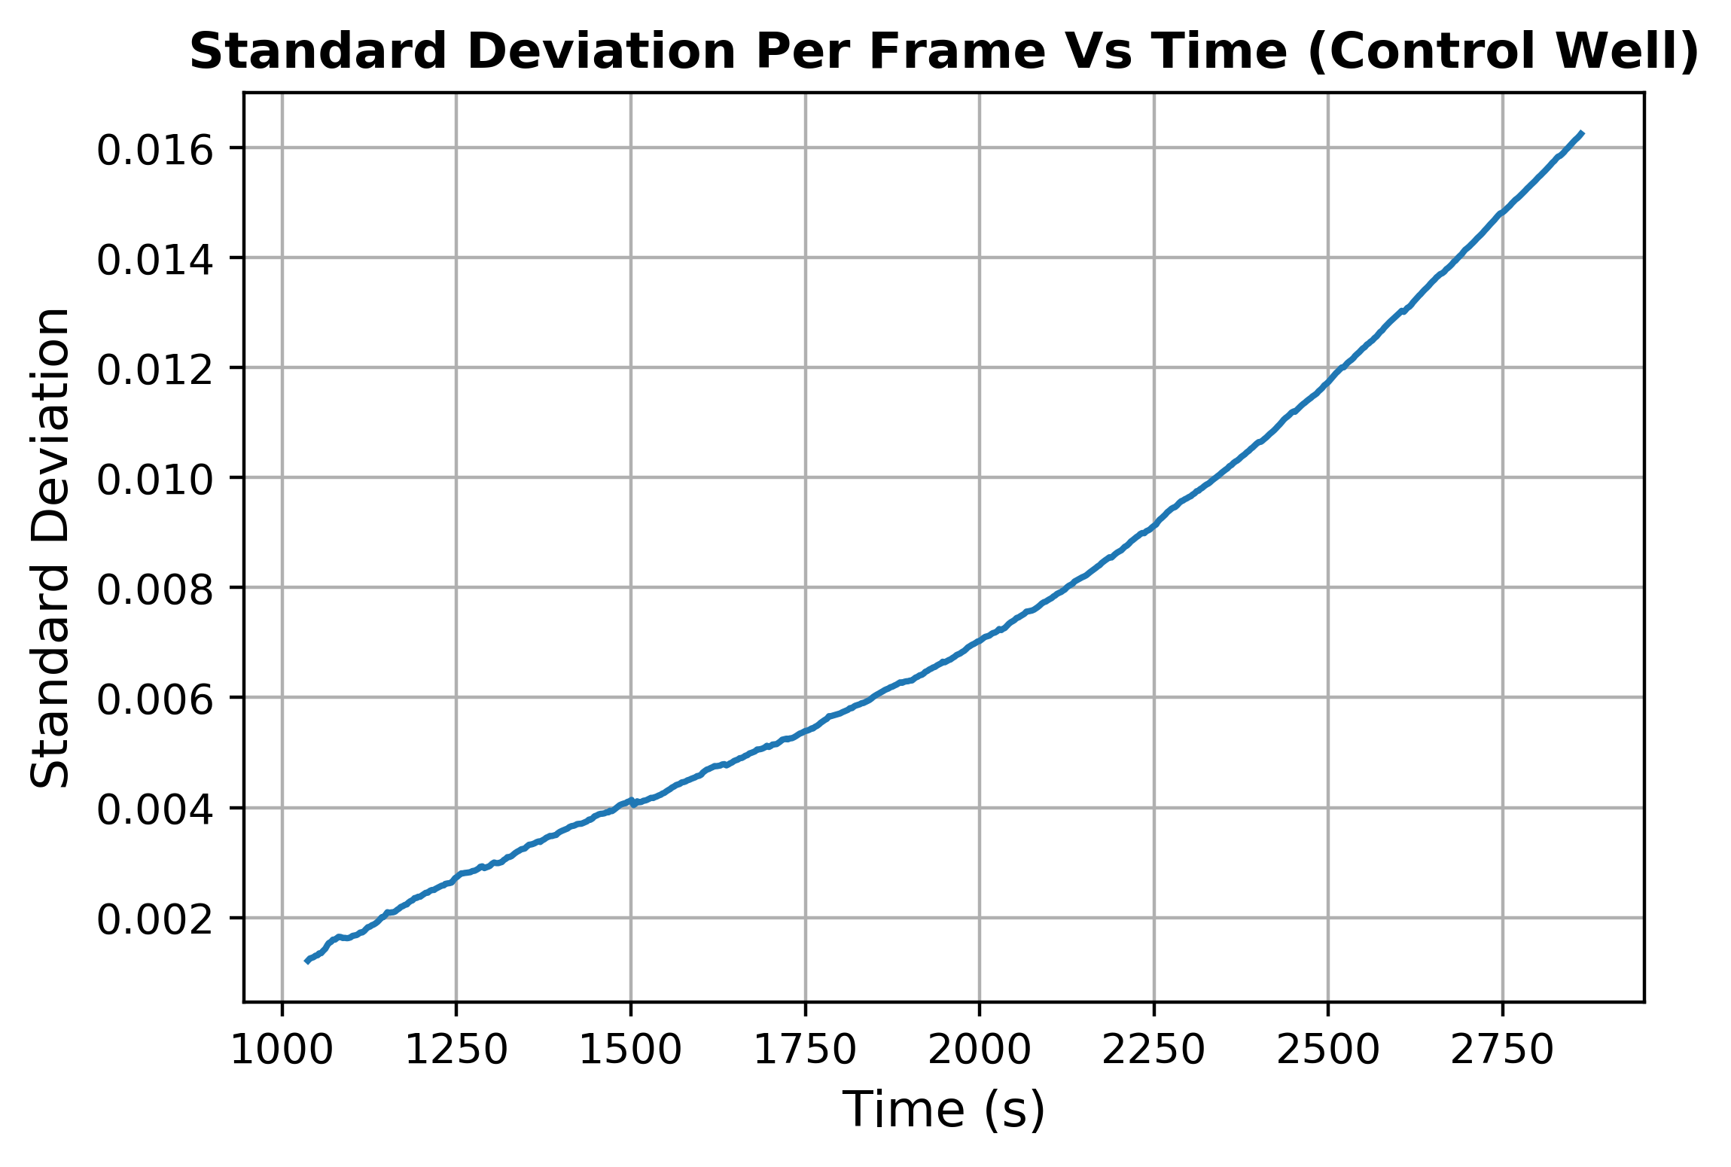
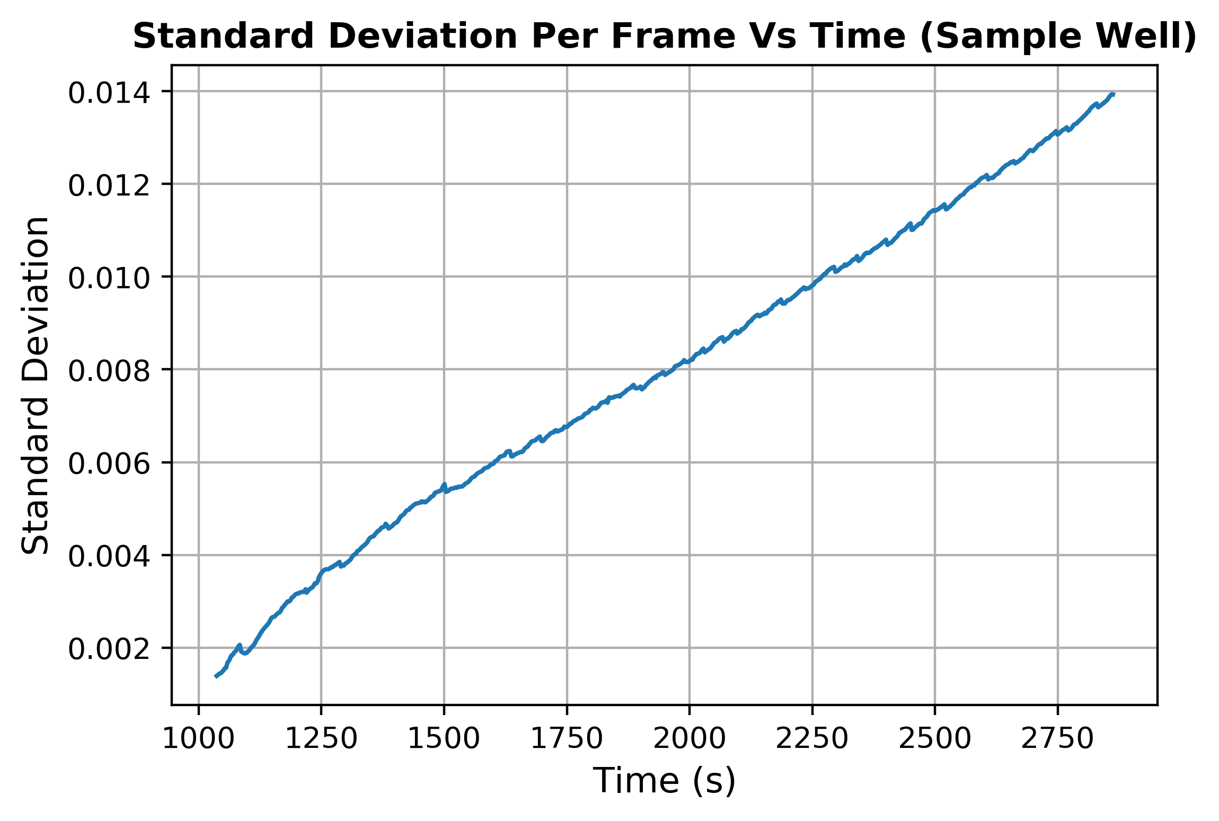
Spatio-Temporal Algorithm
Algorithms - Validation
Spatial Standard Deviation Signals
Amplification?

Slide 26
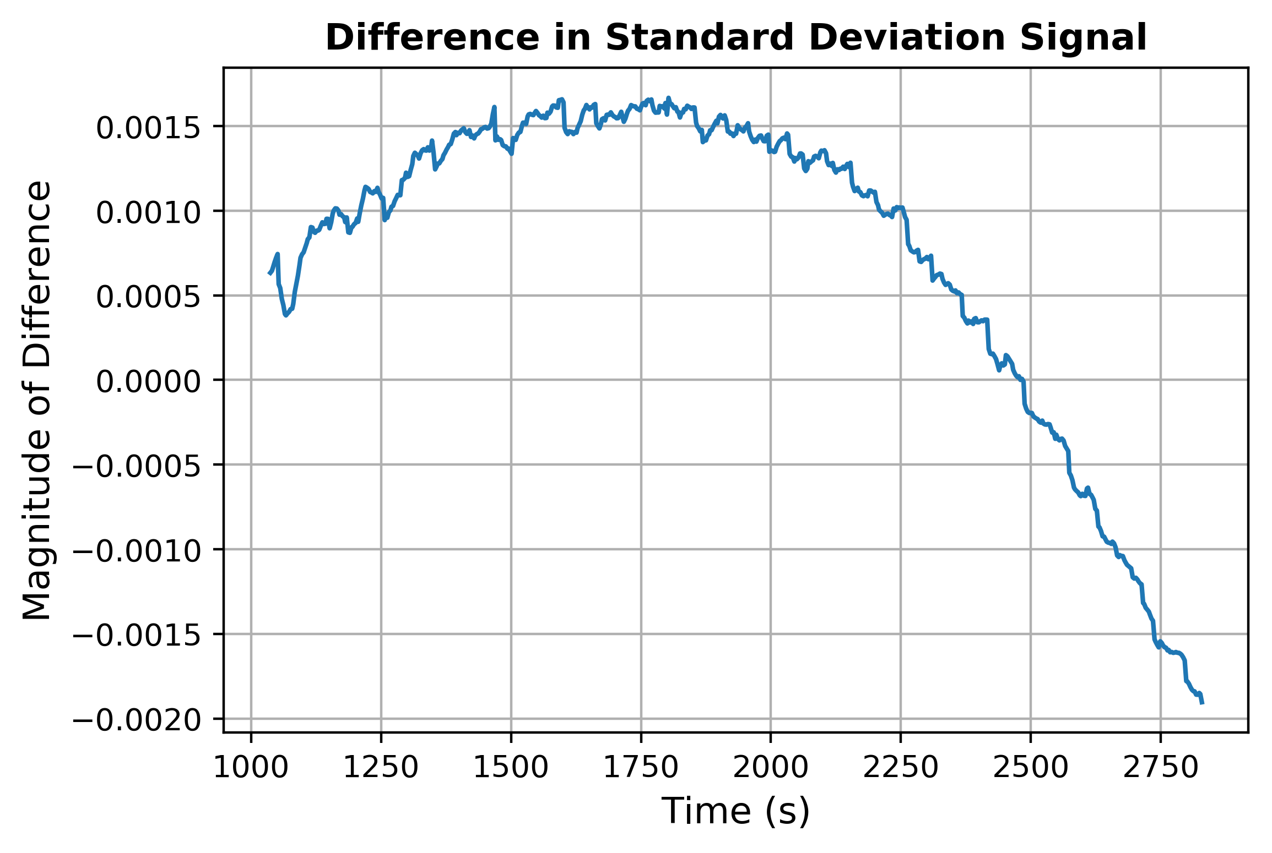
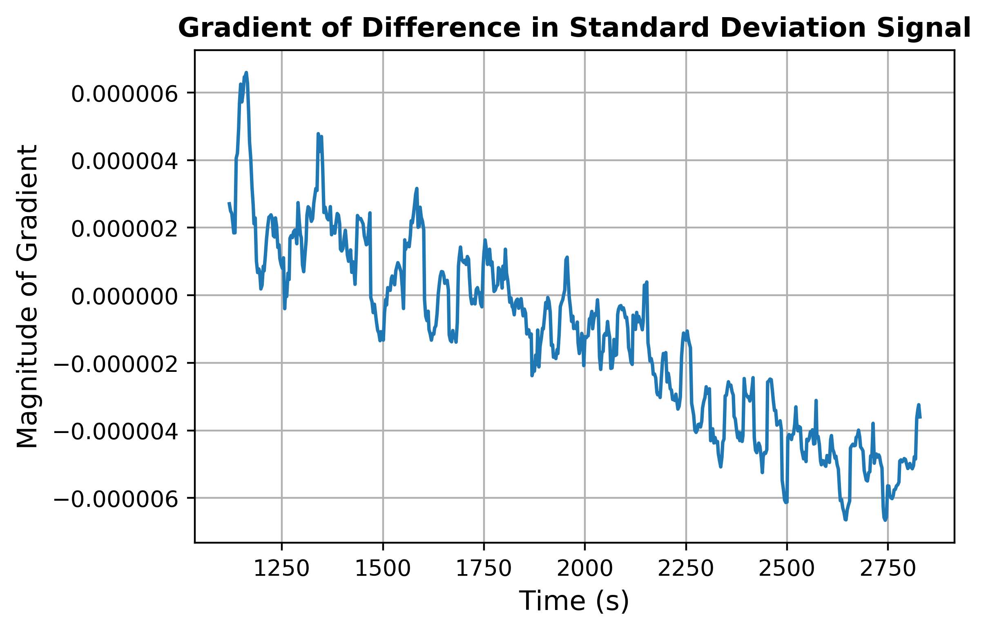
Spatio-Temporal Algorithm
Algorithms - Validation
Difference in Standard Deviation, determination of TTP
Gradient
1-sample rolling difference, divided by 3 (frame rate)
Plot 30 sample rolling mean for smoothing
Peak @ 1130 seconds, TTP = 412s
54% improvement
Limited validation, scope for improvement
Noisy (despite rolling average)
Follows previously seen shape

Slide 27
Conclusions
Two contributions to the field of PoC DNA Diagnostics
Notes:
1 min for this section

Slide 28
1. Mathematical Model
Conclusions
Improved mathematical model
Spatio-temporal characteristics of LAMP
Physical layout of ISFET array
Realistic datasets, transferrable algorithms
Parameterisation throughout codebase: flexibility
Useful for chip and algorithm designers
Notes:
Don’t take too long

Slide 29
2. Algorithms
Conclusions
Novel Spatio-Temporal Algorithm
Improves SNR using drift compensation per pixel
Uses standard deviation for hotspot detection: applicable in this context
TTP improved by 33% on model data
Positive initial result on experimental data, needs further testing and refinement
Notes:
Forget advantages over ML

Slide 30
Thank you!
Any questions?
Notes:
1 min for this section

Slide 31
Background
QnA slides
Notes:
1 min for this section

Slide 32
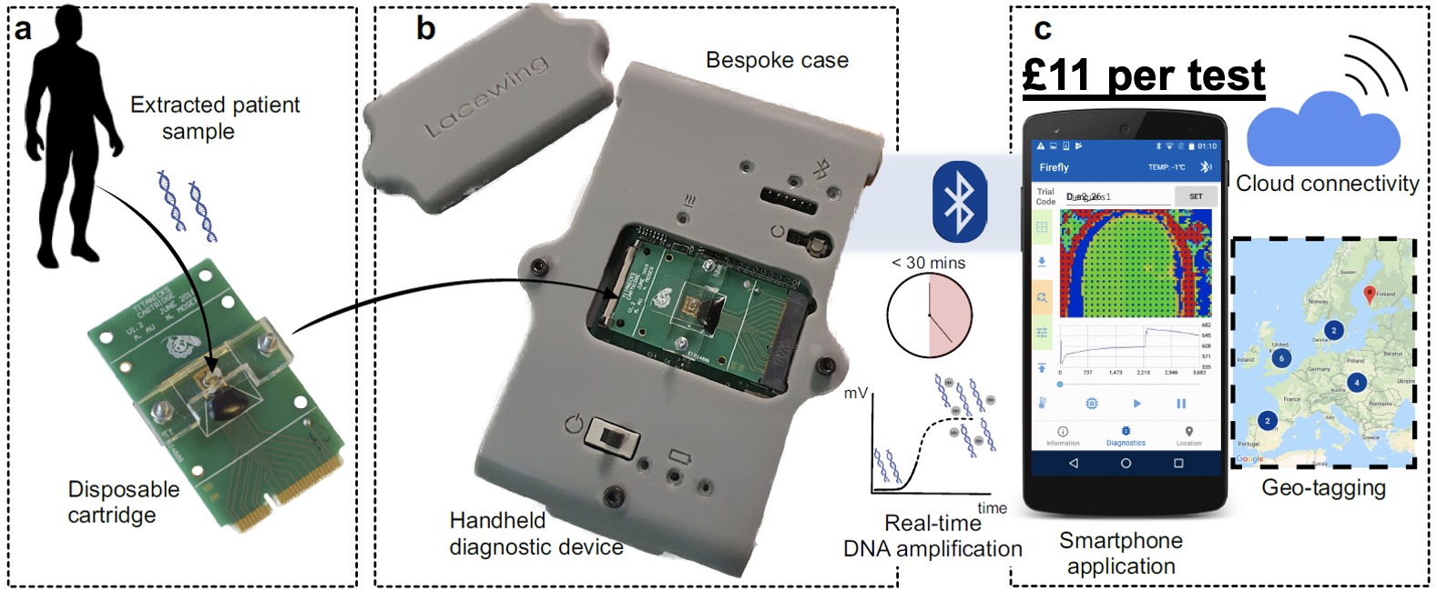
LACEWING
Background Material
Handheld device developed by CBIT
LAMP + ISFETs at base of reaction chamber
Connects to smartphone app for epidemiological surveillance
Cheap (£11), portable, quantitative output, accurate → PoC Diagnostics

Slide 33
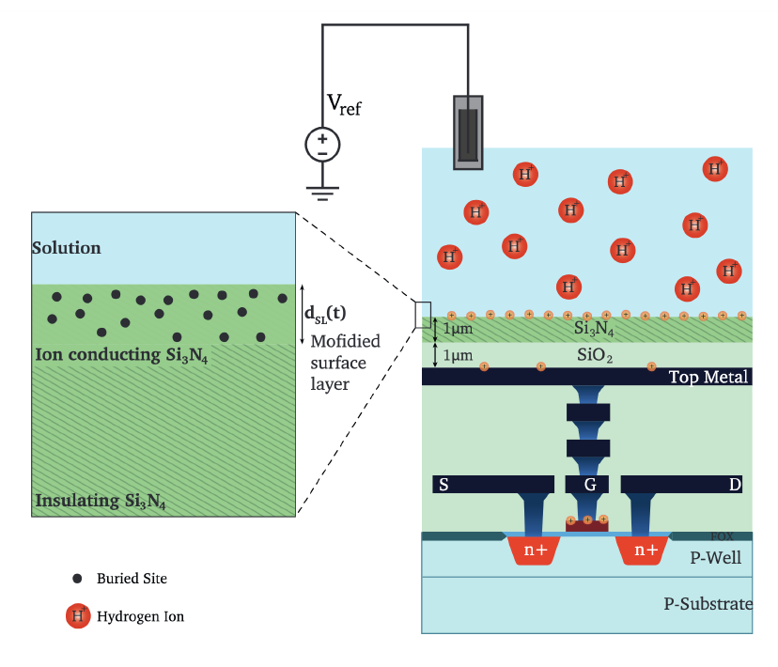
TITANICKS: Signal Non-Idealities
Background Material
1. Sensor Drift
Buried sites of SiOH form trapped charge → protons diffuse to ISFET surface → ISFET output changes independently of LAMP reaction

Slide 34
TITANICKS: Signal Non-Idealities
Background Material
2. Flicker Noise: Release and capture of charge at high frequencies
3. Thermal Noise: Random excitation of charge carriers
Can be thought of as Additive White Gaussian Noise (AWGN):
Additive: Noise is added to the output signal
White: Noise has a uniform frequency spectrum across all frequencies
Gaussian: Noise magnitude has zero-mean normal distribution in time domain

Slide 35
TITANICKS: Output Signals
Background Material
Spatio-Temporal Signal
Temporal Signal
Output of each sensor converted to “image” at different points in time
Regularly spaced MOSFETs for temperature regulation
Gradual darkening of pixels → decay in voltage output
Two ”lobes” → double-well topology, control and sample
Left signal: Control well, purely noise → decaying exponential
Right signal: Sample well, amplification + noise
Amplification detected by change in signal gradient (“kink”) around t=1600s

Slide 36
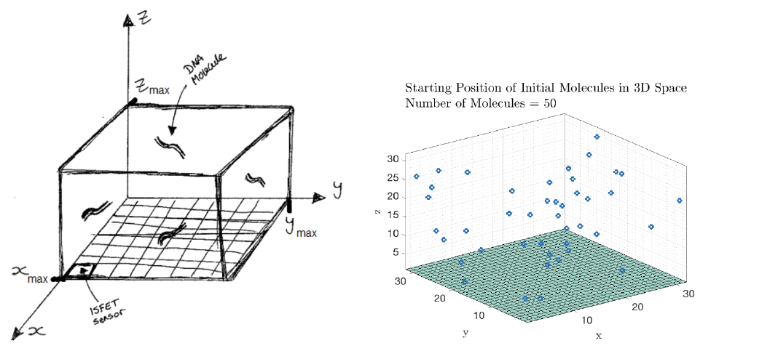
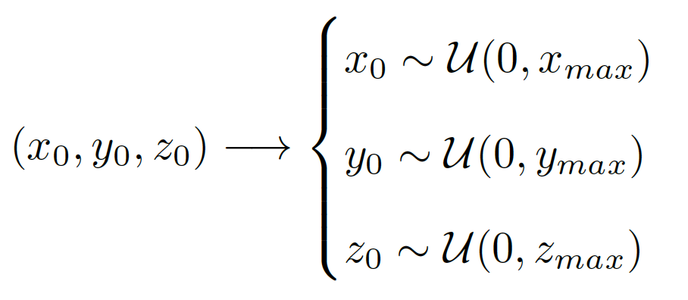
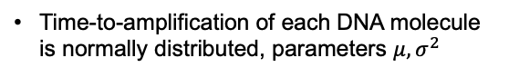
Mathematical Model
Background Material
Goal: model the LAMP reaction on an ISFET array, produce datasets to train algorithms on
Written as a set of MATLAB scripts
1. Initialization of Reaction
Geometry of LAMP reaction modelled in code
Starting position of initial DNA molecules drawn from uniform random variables
Time-to-amplification of each DNA molecule is normally distributed, parameters $μ, σ^{2}$

Slide 37
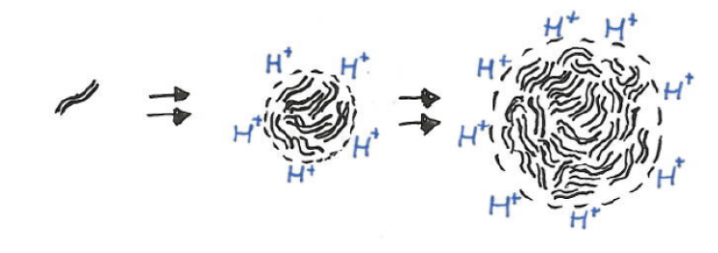
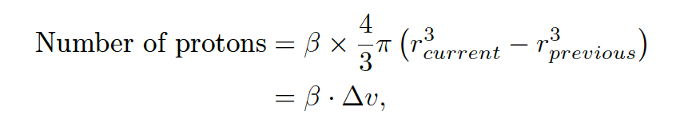
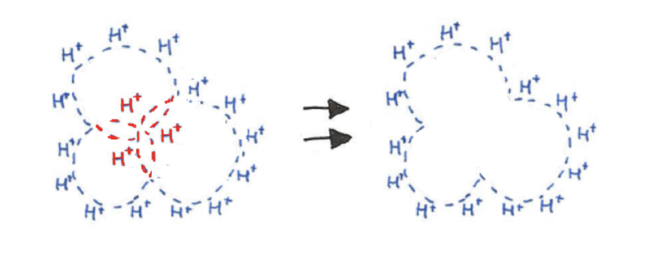
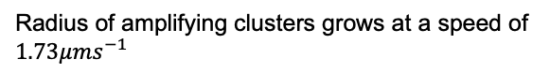
Mathematical Model
Background Material
2. Growth of DNA molecule clusters and release of protons
Radius of amplifying clusters grows at a speed of $1.73μms^{−1}$
Protons released within other clusters are removed (no reactant available)

Slide 38
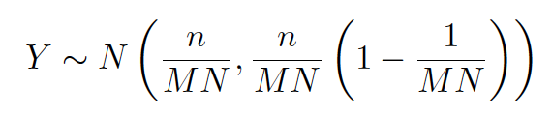
Mathematical Model
Background Material
3. Number of protons detected per ISFET
Assuming:
A proton is equally likely to be detected by any of the ISFETs on the array (size M x N),
n protons in solution,
Number of protons detected by each ISFET is drawn from a random normal variable (proof omitted):
4. Duration of simulation
$t_{total}$ minutes of reaction simulated, proton release and detection conducted every $τ$ seconds
Simulation runtime < 5 seconds

Slide 39
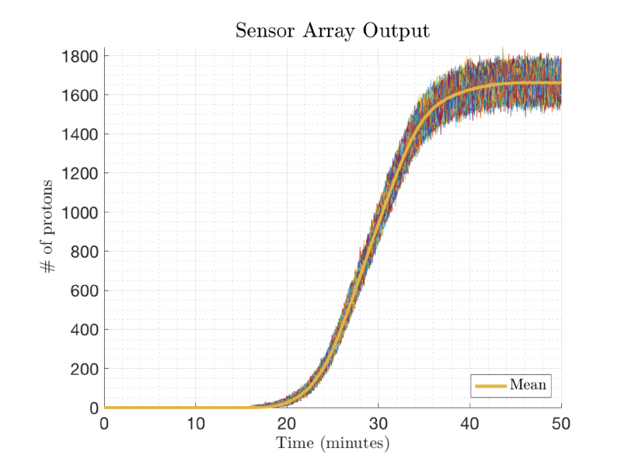
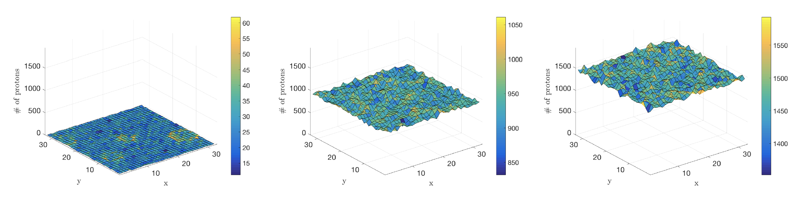
Mathematical Model
Background Material
5. Model Output
Spatio-Temporal Signal
Temporal Signal
Number of protons detected per ISFET over time
Number of protons by ISFET array over time
Discrepancies between model and experimental output
Type of output: number of protons detected vs voltage
Noise not modelled
Randomly assigning protons to ISFETs → loss of spatial information (since protons are released in clusters)

Slide 40
TITANICKS: Signal Non-Idealities
Background Material
1. Sensor Drift
Buried sites of SiOH form trapped charge → protons diffuse to ISFET surface → ISFET output changes independently of LAMP reaction

Slide 41
TITANICKS: Signal Non-Idealities
Background Material
2. Flicker Noise: Release and capture of charge at high frequencies
3. Thermal Noise: Random excitation of charge carriers
Can be thought of as Additive White Gaussian Noise (AWGN):
Additive: Noise is added to the output signal
White: Noise has a uniform frequency spectrum across all frequencies
Gaussian: Noise magnitude has zero-mean normal distribution in time domain

Slide 42
TITANICKS: Output Signals
Background Material
Spatio-Temporal Signal
Temporal Signal
Output of each sensor converted to “image” at different points in time
Regularly spaced MOSFETs for temperature regulation
Gradual darkening of pixels → decay in voltage output
Two ”lobes” → double-well topology, control and sample
Left signal: Control well, purely noise → decaying exponential
Right signal: Sample well, amplification + noise
Amplification detected by change in signal gradient (“kink”) around t=1600s

Slide 43
Mathematical Model
Background Material
Goal: model the LAMP reaction on an ISFET array, produce datasets to train algorithms on
Written as a set of MATLAB scripts
1. Initialization of Reaction
Geometry of LAMP reaction modelled in code
Starting position of initial DNA molecules drawn from uniform random variables
Time-to-amplification of each DNA molecule is normally distributed, parameters $μ, σ^{2}$

Slide 44
Mathematical Model
Background Material
2. Growth of DNA molecule clusters and release of protons
Radius of amplifying clusters grows at a speed of $1.73μms^{−1}$
Protons released within other clusters are removed (no reactant available)

Slide 45
Mathematical Model
Background Material
3. Number of protons detected per ISFET
Assuming:
A proton is equally likely to be detected by any of the ISFETs on the array (size M x N),
n protons in solution,
Number of protons detected by each ISFET is drawn from a random normal variable (proof omitted):
4. Duration of simulation
$t_{total}$ minutes of reaction simulated, proton release and detection conducted every $τ$ seconds
Simulation runtime < 5 seconds

Slide 46
Improvements to model
QnA slides
Notes:
1 min for this section

Slide 47
Improvements to Mathematical Model
Mathematical Model - Methodology
Aims
More realistic modelling of the spatial variation of proton release
Conversion of signal output from number of protons detected changes in ISFET threshold voltage
Addition of signal non-linearities (sensor drift and AWGN) to voltage output
Goal: Realistic output datasets that improve the transferability of algorithms to LACEWING

Slide 48
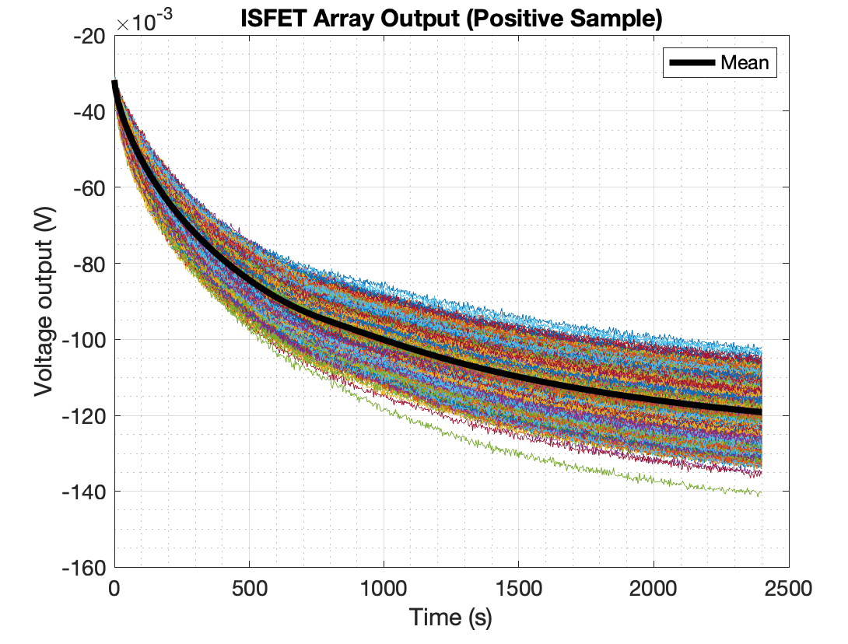

Output of Improved Model
Mathematical Model – Results of Voltage Conversion
Temporal Signal
Spatio-Temporal Signal
1.
of solution within one Debye Length
2.
Sensor drift parameters from curve fitting
3. AWGN
Notes:
Remove (explain later)

Slide 49


Physical Characteristics of TITANICKS
Mathematical Model – Spatial Variation of Proton Release
Current model assumes a perfectly continuous array of ISFETs – this is not true

Slide 50



Detection Distance: Debye Length
Mathematical Model – Spatial Variation of Proton Release
How far above an ISFET does a proton need to be for detection?
ISFET immersed in chemical solution → negative trapped charge attracts protons
Protons form a layer on the surface of the ISFET → Electrical Double Layer (EDL)
Effect of charge carrier on ISFET output decreases exponentially as it moves further away from the EDL
Thickness of EDL = Debye Length, $λ_{D}$
For this solution, $λ_{D}=6.57nm$.
Literature values are order ${10}^{−9}m.$

Slide 51
Detection Distance: Debye Length
Mathematical Model – Spatial Variation of Proton Release
Revised model of ISFET: cuboid

Slide 52

Motion of protons
Mathematical Model – Spatial Variation of Proton Release
From point of production to detection distance
Existing model: number of protons detected per ISFET =
Assumes:
Protons released at the edge of clusters instantaneously reach the ISFET array
Protons are equally likely to land on any ISFET sensor
Truth:
Protons will take a certain amount of time, $Δt$, to reach the ISFET array
The final position of a proton is likely to be dependent on its initial position
Model diffusion of each proton for spatial signal accuracy

Slide 53


Smoluchowski Equations
Mathematical Model – Spatial Variation of Proton Release
Modelling proton diffusion
Let $\left[X\left(t\right), Y\left(t\right), Z\left(t\right)\right]$ be the position of a diffusing proton at time t. Its position after a certain time delay, $Δt$, is computed using the Smoluchowski Equations:
where
$N_{x}, N_{y}, N_{z} \sim N\left(0,1\right)$ and D is a diffusion constant
Rearranging, we can compute $Δt$, time taken to diffuse to the ISFET array:
Substituting $Δt$ back into the Smoluchowski Equations for X and Y yields its final position on the array.

Slide 54

Physical Characteristics of TITANICKS
Mathematical Model – Spatial Variation of Proton Release
Creation of arrays of permissible coordinates to check if protons fell into gaps

Slide 55


Modelling Proton Diffusion
Mathematical Model – Spatial Variation of Proton Release
Algorithm walkthrough
1. Initialize data structure to store the number of protons detected per ISFET per time step
2. At each time step:
Amplify clusters and release protons, remove protons falling within other clusters
3. For each remaining proton:
Compute time taken to reach Debye Length, $Δt$
Substitute $Δt$ back into Smoluchowski Equations to yield final X and Y coordinates
The proton is detected by an ISFET if and only if:
Its X-coordinate falls within the permissible range
Its Y-coordinate falls within the permissible range
$t+Δt<t_{total}$, i.e the proton is detected before the end of the reaction
If the three conditions are satisfied, add proton to data structure at appropriate location and time step

Slide 56



Conversion to Voltage output
Mathematical Model – Voltage Output
Conversion from number of protons detected to threshold voltage change
Addition of signal non-linearities
Sensor drift
Performing curve fitting of the drift equation to data from 5 real-world experiments:
$α={59.6 mV}/{pH}$ (Nernst Potential)
$k=1.38 ×{10}^{−23}m^{2}kg s^{−1}K^{−1}$ (Boltzmann’s Constant)
$T=336.15 K$ (Solution temperature)
$q=1.602 ×{10}^{−19}C$ (Elementary Charge)
$ΔpH$ is the change in pH in the solution within one Debye Length of the ISFET
2. AWGN
Generating rolling standard deviation of the temporal signal from each ISFET and taking the temporal mean of the signal, AWGN was set to have a magnitude of 0.568mV
$$AWGN \sim N\left(0,1\right)$$

Slide 57



Model Assumptions – 1/5
Mathematical Model – Voltage Output
It is physically accurate to compute $Δt$ instead of assigning it a small value
Smoluchowski equations normally used to compute path of random walk of large molecules – $Δt$ set to a small value (0.1) and displacement computed for each time step
Justification
Computational Complexity
- Compute $Δt$ → O(1) operation
- Set small value and keep modelling path until detection/end of reaction → # of steps unbounded
Physical accuracy of modelling
- Proton diffusion hard to characterize → jumping across H-O bonds in water molecules (Grothuss)
- Assuming a fixed endpoint (but random path to reach it) allows for other assumptions to be made

Slide 58

Model Assumptions – 2/5
Mathematical Model – Voltage Output
Protons can pass through DNA clusters unaffected
Justification
Computational Complexity
Compute potential intersection of proton with all clusters → O( c ) operation, c=# of clusters
Unbounded number of reflections
Physical accuracy of modelling
Protons unlikely to behave in “tennis-ball” like manner (Grothuss mechanism)
More likely: diffusion constant reduces with less water molecules available in more viscous solution. Future work

Slide 59


Model Assumptions – 4/5
Mathematical Model – Voltage Output
Protons falling into gaps between ISFETs are removed
Justification
Computational Complexity
Build array of gap coordinates and check each proton falls into gaps → O(p x (M+N))
If it falls into a gap, check if its path intersected with any walls → average of 5 walls to check → O(p)
Physical accuracy of modelling
Even if we assume protons falling to the side of an ISFET within 1 debye length are detected, inter ISFET separation in TITANICKS = 2$μm$, >>> debye length
Not worth the complexity of modelling

Slide 60
Model Assumptions – 5/5
Mathematical Model – Voltage Output
Conditions for reaction saturation
Justification
1. Total number of protons in solution is strictly positive constant for a certain number of steps (parameter) AND all DNA molecules have begun amplification
Radius of one cluster exceeds the length of the hypotenuse of the reaction chamber → all reactants consumed

Slide 61


Runtime Complexity

Slide 62

Model Parameters

Slide 63

Model Flowchart

Slide 64



Effect of F

Slide 65
Algorithms
QnA slides
Notes:
1 min for this section

Slide 66
Spatio-Temporal Algorithm
Algorithms - Validation
Evaluation
Result from one experiment provides limited validation of algorithm: further testing needed
Noisy gradient signal → drift compensation needs improvement
Curve fitting > 300 seconds (depends on other factors)
Improve chip frame rate → more samples for drift compensation → better SNR
Improve pre-processing: control well temporal signal contained pixels with 0 output, increases standard deviation

Slide 67

Synthetic Datasets

Slide 68

Why 300 samples?
Number of datapoints to use depends on single molecule time-to-amplification & Frame Rate F
Dataset A: Time taken for each DNA molecule to amplify drawn from normal distribution, $μ=13, σ^{2}=3$
$99.7\% of DNA molecules start amplification after 13−3\sqrt{3}=468 seconds$ → signal until t=468 is almost entirely sensor drift + noise.
Conservative: use first 300 seconds, frame rate = 1 → 300 samples

Slide 69


Robustness to noise
Computing differences between top & bottom well improves robustness
Noisy gradient signal
How to define TTP?

Slide 70
Why not ML?
Advantages of standard deviation over ML:
No pre-training, no overfitting
Considers differences between top and bottom well of same chip: environmental & manufacturing factors accounted for
Fast to compute (embedded application)
Low memory requirement (embedded application)
Explainable algorithm vs “black-box” approach → debugging & adaptability
It’s simple and it works*
* subject to testing

Slide 71
Future work
QnA slides
Notes:
1 min for this section

Slide 72
1. Modelling
Justify assumptions & decide if it is worth relaxing them (eg: if reflections off walls only affect spatial signal after region of interest)
Use more physically accurate equations for threshold voltage change
Distribution of Delta t
Error in initial position of protons

Slide 73
2. Algorithms
Evaluate algorithm on experimental data
Improve robustness to noise (assuming unchanged frame rate)
TTP is when gradient signal goes above a threshold epsilon
Improve drift curve fitting by increasing allowable range of parameters
Change definition of “peak” in scipy find_peaks by adaptively controlling number of neighbors to compare against
Alternative method of drift compensation: compute difference between frames, but this did not boost SNR much for me
Alternative methods of detecting hotspots (embedded ML)

